Slide 1
Analysis of the US Housing Market in Two US Cities from 2020-2022
Real Estate Investment Group

Slide 2
Project Goals
To create an efficient model that is able to effectively predict real estate pricing in New York City and Philadelphia.
We used real estate data from the start of the COVID-19 Pandemic up until September 2022, which we used to train and test each of our models.
Then we tested our models with current real estate pricing to see its effectiveness.

Slide 3
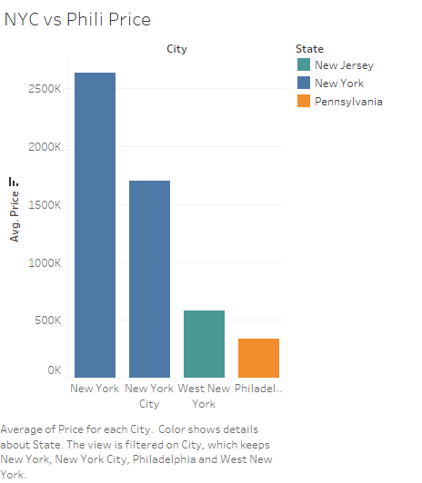
Dataset and EDA
Our primary dataset was procured from (https://www.kaggle.com/datasets/ahmedshahriarsakib/usa-real-estate-dataset), and is comprised of recent real estate listings from across the United States.
Our dataset was filtered down to only listings in the Pennsylvania and New York areas that were sold after 2020.
Our preliminary EDA revealed to us that listings in New York were much more expensive than those in Pennsylvania.

Slide 4
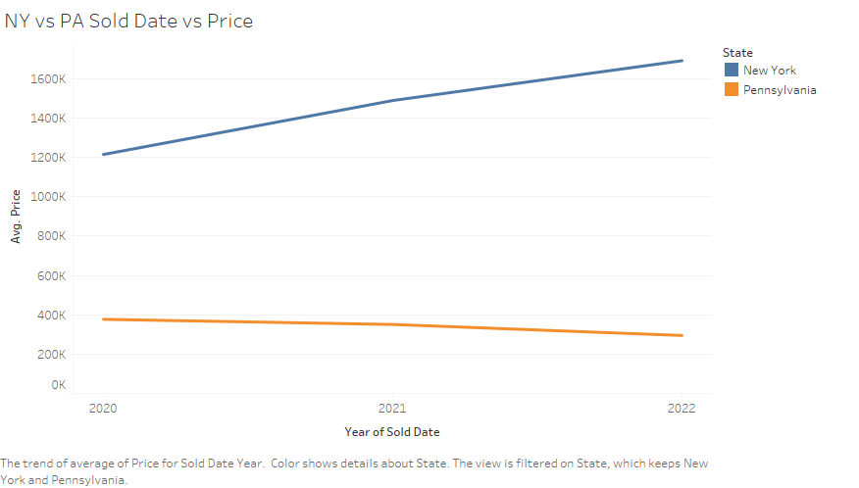
EDA
As seen in the figure here, the selling price in New York skyrocketed up to a steep margin.
However, if we take look at Pennsylvania, the selling price actually went down in the same period that houses were selling in New york.

Slide 5
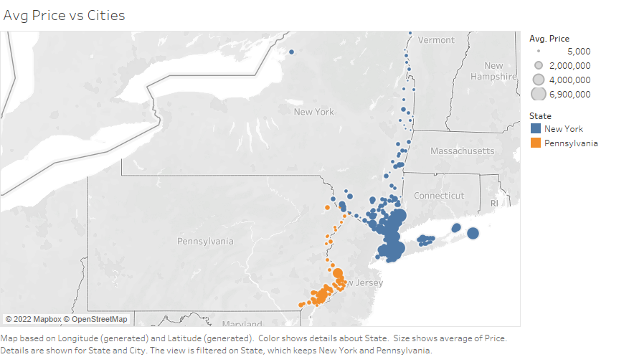
EDA - Location
We did a general analysis on both cities to get the average pricing of homes sold by location.
The average pricing in New York seems to be significantly higher than Philadelphia, as expected.

Slide 6
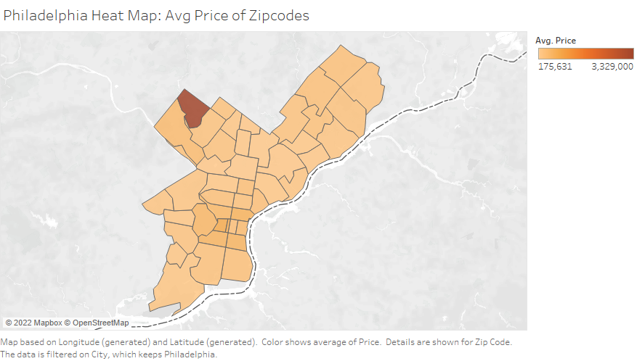
EDA - Location
We made use of another feature to do our EDA to help us find the average pricing of homes sold in the philadelphia region by zip-codes.

Slide 7
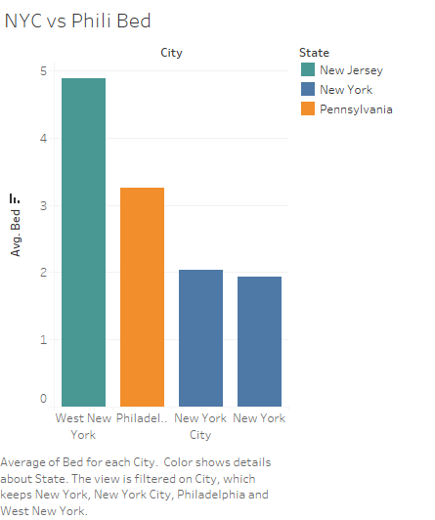
EDA - No. of Bedrooms
It seems that West New York/New Jersey has the highest number of bedrooms in properties.
However, New York City seems to have fewer bedrooms than Philadelphia.

Slide 8
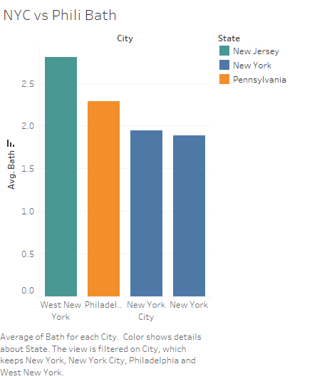
EDA - No. of Bathrooms
West New York/New Jersey also has the highest number of bathrooms of the cities we are analyzing.
Philadelphia, again, is the middle of the pack here.

Slide 9
Current State of Work - Processing
We transformed the String dates within the sold_date column into datetime objects.
Afterwards, we replaced the sold_date columns dates with a numeric representation for how many days after January 2020 the listing was sold.
We then applied LabelEncoder on the city and state columns to turn them into numeric representations
We have dropped all NaN’s in the dataset, for now.

Slide 10
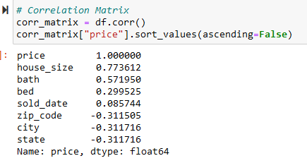
Current State of Work - Correlation
After having done all of that, we created a correlation matrix with respect to price of our data.
As expected from out EDA, bath and bed were very correlated with price, as well as the house location. However of all features, house_size was most strongly correlated with price, something we did not discover during EDA.

Slide 11
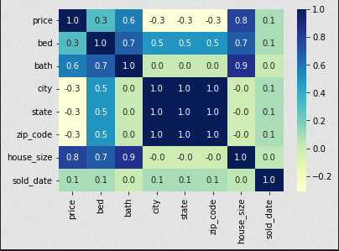
Correlation Matrix and Feature Selection
In this visualization of the correlation matrix we can see things clearer. There is a curious block in the middle, caused by city, state, and zip_code all being strongly correlated with one another.
Based on this, during the Feature Selection Process we decided to drop city and state as data features, as zip_code already exists.

Slide 12
Preliminary Modelling
As of now we have begun working on the first group of machine learning models. We plan to evaluate - a Logistic Regression model.
The model still requires further work, but the basic model had an accuracy of around 27%, which is not ideal for the result we are looking for.

Slide 13
Regression Model to Predict the most important variables influence Amount Total
Multicollinearity VIF<5
How to remove outlier Remove the records more than 3 SD from Mean
R2 =1
MSE 1.51e+07
MAE 2.85e+02
RMSE 3.88e+03

Slide 14
Regression Model to Predict the most important variables influence Amount Total
Variable Name | P-Value
CensusTractMinorityRatioPercent | 0.0
CensusTractMedFamIncomeAmount | 0.0
LoanAcquisitionActualUPBAmt | 0.0
NoteDate | 0.001
LoanPurposeType | 0.002
MortgageType | 0.05
BorrowerFirstTimeHomebuyer | 0.028
Borrower2CreditScoreValue | 0.00
Borrower2Race5Type | 0.00

Slide 15
Things we Need To Improve
How can we handle Multicollinearity?
How to handle variable with high skew and kurtosis?
Log Transformation
How apply AIC & BIC to improve model performance?

Slide 16
Future Steps
As we go further in our analysis we intend to make use of other ML models which include:
Decision Tree
K-means
KNN
Artificial Neural Networks
Then we will have to assess the accuracy and precision of our models to decide which one produces the best results.
Finally, after finding the best model, we will be able to propose the most appropriate model to use, and be able to test that model with current real estate data from this year in order to verify its effectiveness.

Slide 17
THANK YOU

